Slide 1
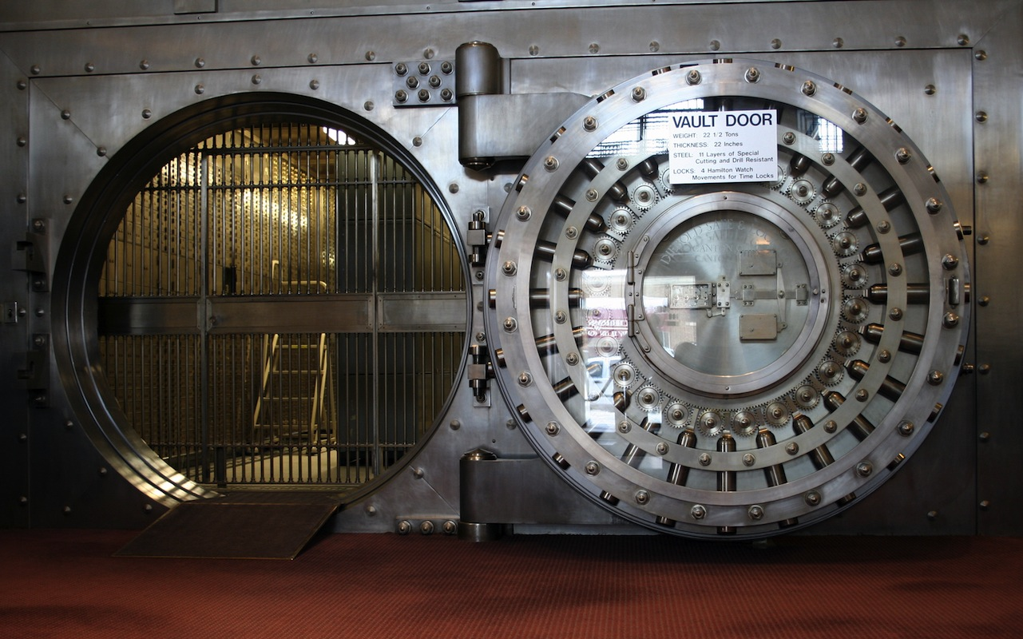
Heist
Team 15

Slide 2
The Story
You are an ordinary man, with honest motives but questionable morals, that has agreed to take part in a bank heist.
Your goal is to manoeuvre through the bank towards the vault, in which you’ll find the riches you desire.
Using a mixture of items the player has purchased during the pre-planning phase, and various items found scattered throughout the bank, the character must find a way to complete the tasks and final goal efficiently.

Slide 3
Defining Features
While text-based games all follow a similar format, this game has some defining features that make it stand out.
Limited Turns: The tasks and final goal (stealing the money), must all be completed within a set number of turns. Failure to complete everything within this limit will result in a failed attempt.
Scaled Victory: Assuming that you have completed the main objective within the set number of turns, the amount of money that you are able to take is based upon how many turns you have remaining. The less turns needed to finish the game = more money, and a higher score!
A rich back story, with a wide variety of interactive options that will influence the final outcome of the game, including a pre-planning phase that allows you to purchase useful items.

Slide 4
Game Mechanics
It is a classic text-based adventure game, programmed using Python.
The basic commands, and clarity of objectives, makes this game suitable for players of all abilities.
?
?

